Slide 1
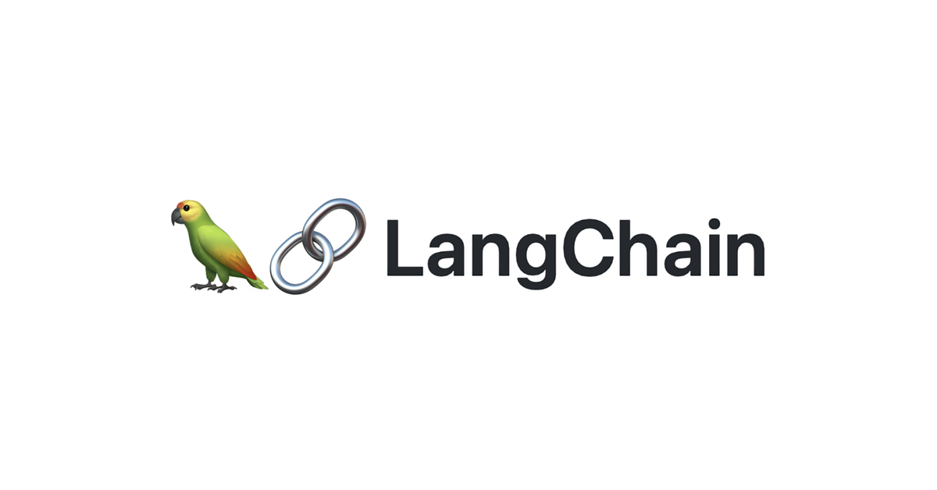
RAG from scratch: Indexing
Lance Martin
Software Engineer, LangChain
@RLanceMartin
Notes:
This is the second video in our series on RAG. The aim of this series is to build up an understanding of RAG from scratch, starting with the basics of indexing, retrieval, and generation. This video focuses on indexing, covering the process of document loading, splitting, and embedding. See this notebook for code: https://github.com/langchain-ai/rag-from-scratch/blob/main/rag_from_scratch_1_to_4.ipynb

Slide 2
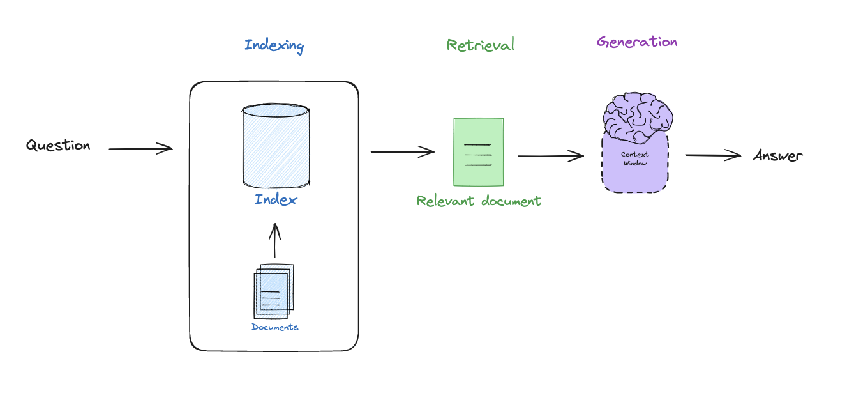
RAG motivation
Notes:
In the last video, we walked through the basic components of RAG: (1) indexing (make external data retrievable), (2) retrieval (fetch external data that is relevant to a query that we want the LLM to reason about, (3) generation pass this to an LLM to generate an answer.

Slide 3
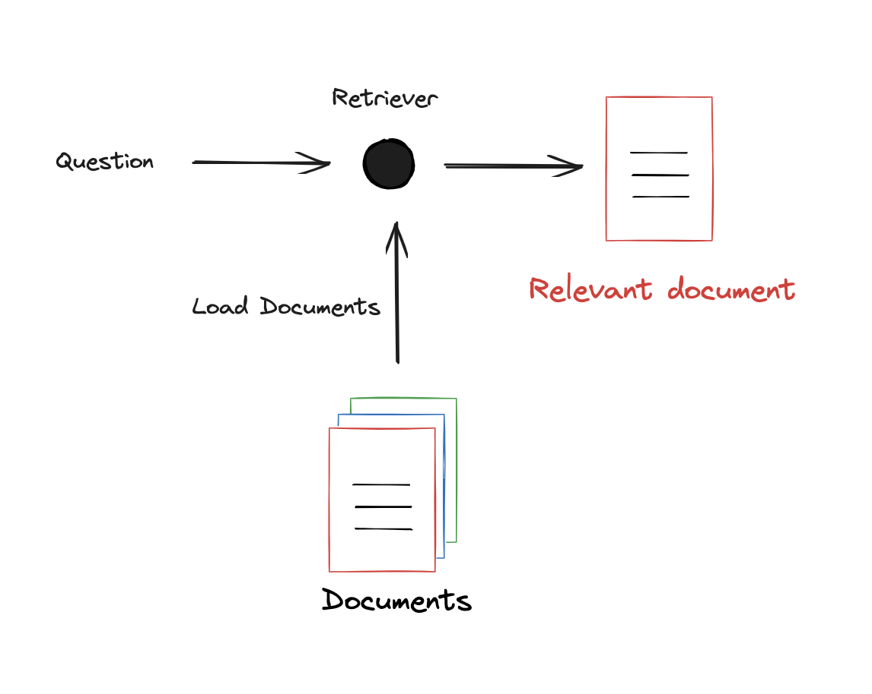
Document loading
https://integrations.langchain.com/
Notes:
Here’s we’ll talk about indexing, which start with loading documents. LangChain has > 160 different document loaders that you can use to grab data from many different sources for indexing.

Slide 4
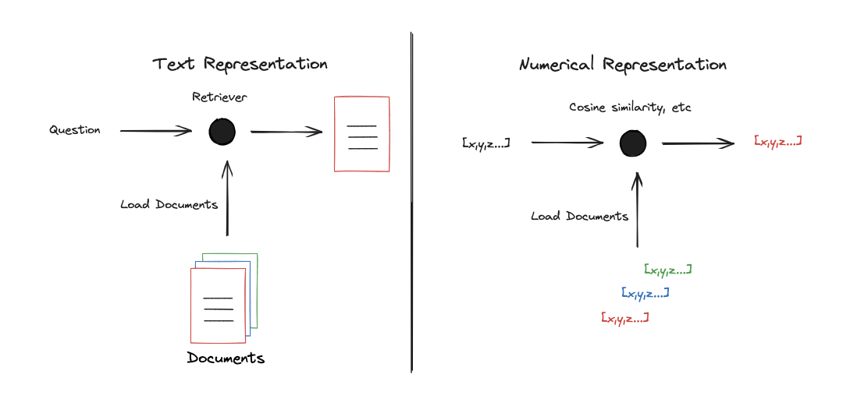
Numerical representation for search
Notes:
But, we need an efficient way to search over this loaded data. This is a well-studied problem, which typically involves mapping documents to a numerical representation, such as a vector. If documents are mapped to vectors, there are many way to perform search for similarity between vectors.

Slide 5
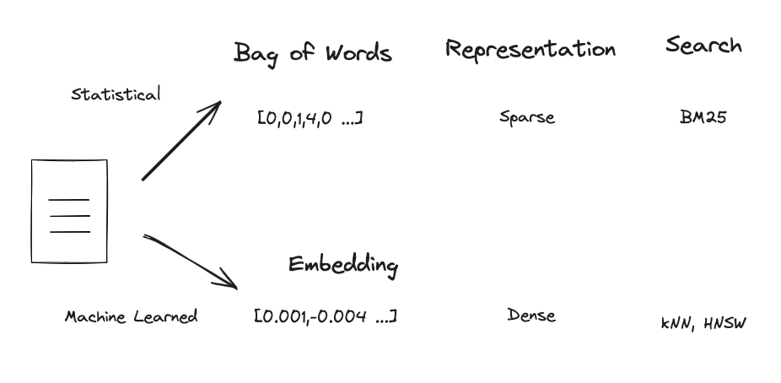
Statistical and machine learned representations
https://simonwillison.net/2023/Oct/23/embeddings/
https://www.pinecone.io/learn/series/nlp/dense-vector-embeddings-nlp/
https://cameronrwolfe.substack.com/p/the-basics-of-ai-powered-vector-search?utm_source=profile&utm_medium=reader2
Notes:
Of course, this has been around for a long time: statistics methods like Bag Of Words look at word frequencies in documents to build a vector. These are typically considered “sparse” because the each position in the array will represent a possible word in a large vocabulary, so there will be many zeros. There are well developed methods to search using this representation.
Machine learned approaches, embedding models, have also emerged for this task. These map text to a fixed length vector, which compresses the semantic meaning And similarly there are good methods for search across embedded vectors.

Slide 6
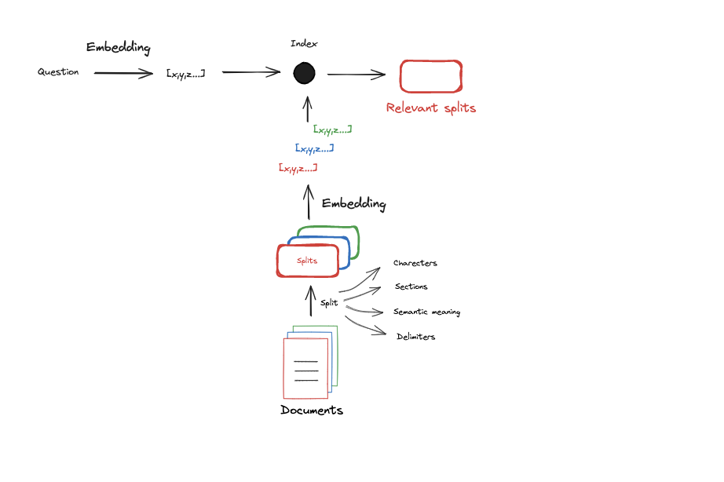
Loading, splitting, and embedding
https://chunkviz.up.railway.app/
https://www.youtube.com/watch?v=8OJC21T2SL4
Notes:
With this in mind, indexing is the process of taking documents and mapping them to a representation that is easily searchable. For many LLM applications, embedding models have been used. And because LLMs and embedding models have a limited context window, often documents are split up before they are embedded.

Slide 7
Code walk-through

